Slide 1
Idea Title:
Personalized Financial Guidance: Interactive UI and Generative AI
in the Banking Sector
Presentation Challenge 6: Personalized Content Generation
Bank of Baroda Hackathon 2024
Team Name : Codiologist
Team Bio : Keshan (AI/ML Researcher); Tushar ( Solution Architect at Accenture)
Date : 30/7/2024

Slide 2
Problem Statement
The objective is to create an AI-powered system for personalized content generation in the banking sector, focusing on financial reports, marketing campaigns, and educational materials. By leveraging Azure OpenAI's capabilities, the system will securely process customer data, using generative AI to provide customized reports, targeted marketing messages, and tailored educational content.
Personalized Financial Reports: Generate personalized reports summarizing account activities, investments, and savings trends, with actionable financial advice.
Tailored Marketing Campaigns: Analyze customer behavior and preferences to create targeted marketing messages, enhancing engagement and conversion rates.
Educational Content Personalization: Deliver educational materials tailored to customers' knowledge levels and learning preferences, empowering them with relevant financial knowledge.
This solution aims to enhance customer satisfaction, build trust and loyalty, and improve financial literacy among bank customers.

Slide 3
Pre-Requisite
Current market alternatives/competitive products:
Kasisto KAI:
An AI platform providing personalized financial insights and interactive customer support via chatbots, helping banks enhance user experience and engagement.
Cleo
A digital assistant focusing on financial management and personalized advice, appealing particularly to younger customers by combining conversational AI with financial insights.
Erica
A virtual assistant utilizing natural language processing to offer personalized banking services, including financial reports and guidance.
NatWest Cora+
An AI-powered assistant that provides personalized banking assistance and is being enhanced with generative AI to improve customer interactions.

Slide 4
Tools or resources
Azure AD B2C (Azure Active Directory B2C)
Azure App Service
Azure Functions
Azure Open AI
Azure Cognitive Services
Azure SQL Database
Azure Cosmos DB
Azure Monitor
Managed Identity
Key Vault

Slide 5
Any Supporting Functional Documents
User Authentication: Customers authenticate via Azure AD B2C.
Data Ingestion: Customer data is ingested and processed using Azure Data Factory and stored in Azure SQL Database or Cosmos DB.
Data Processing: Azure Databricks processes the data, performing analytics and preparing it for model training.
Model Training: Generative AI models are trained and fine-tuned using Azure Databricks and Azure Cognitive Services.
Content Generation: Personalized content is generated using the trained AI models and delivered through Azure Functions and Logic Apps.
Content Delivery: The personalized content is served to customers via the frontend web app hosted on Azure App Service.
Monitoring and Security: The entire system is monitored and secured using Azure Monitor and other security services.

Slide 6
Key Differentiators & Adoption Plan
Scalability and Flexibility:
Utilizes Azure's scalable services like Azure Functions, Azure Databricks, and Azure Synapse Analytics, allowing the system to handle varying loads efficiently.
Integrated AI and Machine Learning:
Employs Azure Cognitive Services and Azure Databricks for generative AI and machine learning, enabling advanced content personalization based on customer data.
Seamless Data Integration:
Azure Data Factory facilitates seamless integration and ETL processes from multiple data sources, ensuring comprehensive and up-to-date customer data.
Global Reach and High Availability:
Azure Front Door provides global load balancing and routing, ensuring low latency and high availability of the system for customers worldwide.
Security and Compliance:
Azure AD B2C ensures secure user authentication, while Azure Monitor and security services maintain system security and compliance with industry regulations.

Slide 7
Key Differentiators & Adoption Plan
Serverless Architecture:
Azure Functions and Logic Apps enable a serverless architecture, reducing infrastructure management overhead and allowing focus on business logic and workflows.
Advanced Analytics:
Azure Synapse Analytics offers powerful data warehousing and analytics capabilities, enabling detailed insights and data-driven decision-making.
Customizable and Extensible:
Azure API Management provides a flexible API gateway, allowing easy integration with external applications and services, and enabling future extensibility.
Cost Efficiency:
The pay-as-you-go model of Azure services ensures cost efficiency by only charging for actual usage, making it suitable for both large and small-scale deployments.
User-Centric Design:
The solution prioritizes customer engagement and satisfaction by leveraging personalized content generation, enhancing the overall customer experience with the bank.

Slide 8
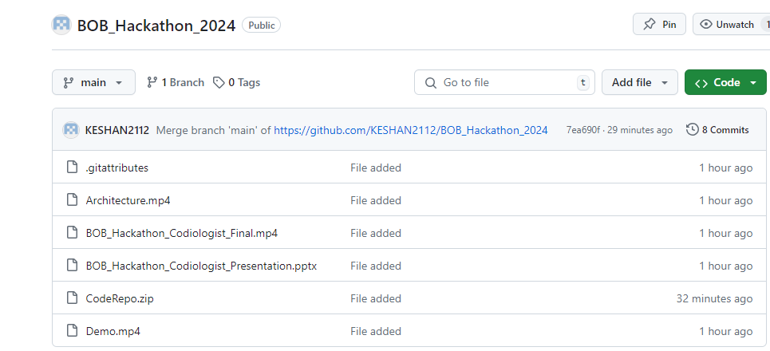
GitHub Repository Link & supporting diagrams, screenshots, if any
Github Link: https://github.com/KESHAN2112/BOB_Hackathon_2024

Slide 9
Business Potential and Relevance
Personalized Marketing Campaigns
Customer Relationship Management (CRM)
Financial Advisory Services
Educational Content Delivery
Product Recommendations
Customer Support
Targeted Promotions
Retention Strategies
User Experience Enhancement
Data-Driven Insights
Regulatory Compliance
Brand Differentiation

Slide 10
Uniqueness of Approach and Solution
Advanced AI Capabilities
Integration with Azure Ecosystem
Real-Time Personalization
Comprehensive Data Utilization
Scalability and Flexibility
Enhanced Customer Experience
Operational Efficiency
Innovation and Competitive Edge
While the current products offer various personalization features, they do not fully cater to individualized user needs. Our solution leverages Generative AI to provide personalized recommendations, overcoming these limitations and delivering a truly customized experience.

Slide 11
User Experience
Personalized Interactions
Enhanced Relevance and Timeliness
Improved Financial Literacy
Increased Convenience
Enhanced Engagement
Building Trust and Loyalty
Effortless Financial Management
Continuous Improvement

Slide 12
Scalability
Cloud Infrastructure
Distributed Architecture
Data Management
AI and Machine Learning
API Management
Performance Optimization
Monitoring and Analytics
Security and Compliance

Slide 13
Ease of Deployment and Maintenance
Implementation:
Azure Services Integration: Utilize Azure services such as Azure Machine Learning, Azure Data Lake, and Azure Analytics for seamless integration of AI models and data processing.
Development Tools: Azure provides robust development tools and APIs, streamlining the implementation process for AI-driven content generation.
Scalable Infrastructure: Leverage Azure's scalable cloud infrastructure to handle varying workloads and data volumes without manual intervention.
Security and Compliance: Azure offers built-in security features and compliance certifications, ensuring data privacy and regulatory adherence from the outset.
Maintenance:
Automated Monitoring: Utilize Azure Monitor and Application Insights for automated monitoring of AI model performance, system health, and user interactions.
Continuous Improvement: Implement Azure Machine Learning for automated model retraining and optimization based on real-time data insights and user feedback.
Managed Services: Azure's managed services reduce the overhead of routine maintenance tasks, allowing focus on strategic improvements rather than day-to-day operations.
Support and Documentation: Access Azure's extensive support resources and documentation to address any operational issues and stay updated on best practices.

Slide 14
Security Considerations
Azure Security Center
Identity and Access Management (IAM)
Data Encryption
Network Security
Data Compliance
Threat Detection and Monitoring
Patch Management
Backup and Disaster Recovery
Security Best Practices
Personal Identifiable Information (PII) Reduction

Slide 15
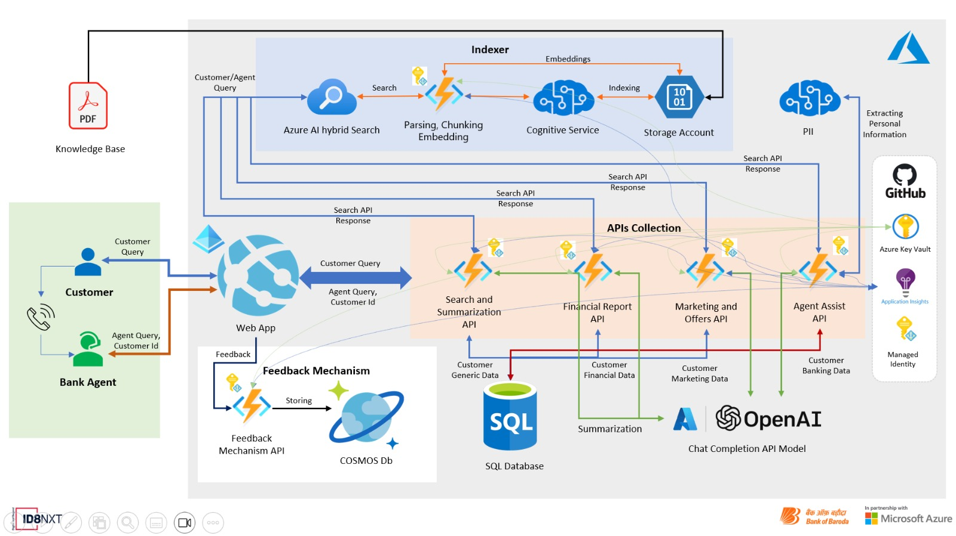
Architecture

Slide 16

Solution Video & Github Link
Github Link: https://github.com/KESHAN2112/BOB_Hackathon_2024

Slide 17
Thank You
Keshan Srivastava
Tushar Gupta

